Slide 1
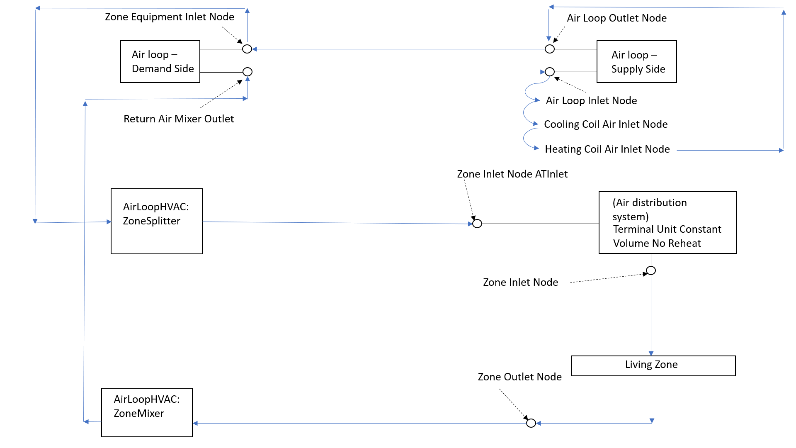
Airloop
Derived from figure available on https://www.linkedin.com/pulse/energyplus-airflow-network-modeling-simple-house-chandan-sharma

Slide 2
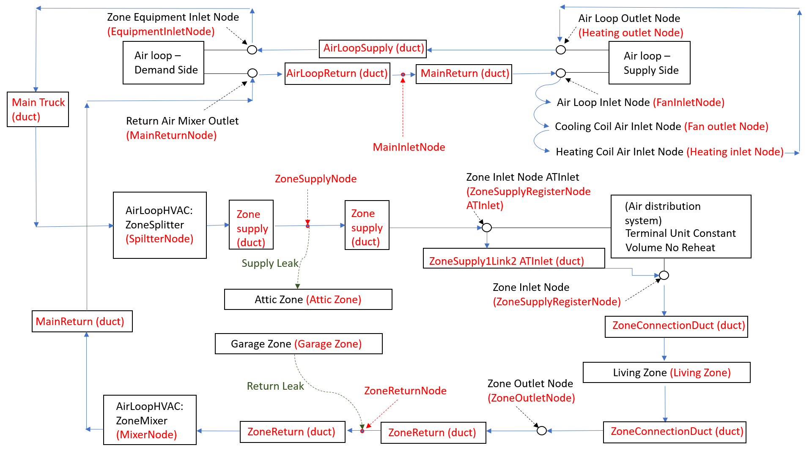
AFN: Crawlspace
Supp Heating Coil
(HeatingOutletNode)
Supp Heating Coil Air Inlet Node
(SuppHeatingInletNode)
Main Heating Coil
MainTrunk (duct)
Suppyly Fan
(MainInletNode)
(FanOutletNode)
Main Cooling Coil
(HeatingInletNode)
Located in Attic Zone
ZoneSupplyLink2 ATInlet Duct
Crawlspace (zone)
Located in Crawl Zone
Located in Living Zone
Derived from figure available on https://www.linkedin.com/pulse/energyplus-airflow-network-modeling-simple-house-chandan-sharma

